Slide 1
ERROR HANDLING
Best practice in ASP.NET Web API

Slide 2
Purpose of this presentation
Error handling is often considered too late
Today, Platform handling ≠ Transparency handling
Trace One should use only one error handling model
in order to
Better define exception scenarios
Get a More predictable system
Make debugging easier

Slide 3
Categories of errors
Error specification
Setting up the API : Models & Controller
Throwing and Catching
Validation Pipeline

Slide 4
Categories of errors
Server errors
Client input errors
Client business Errors
Who is responsible ?

Slide 5
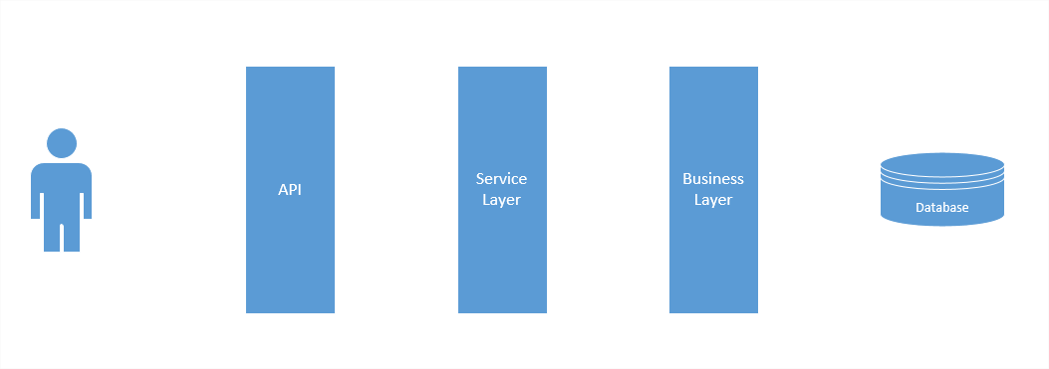

Categories of errors
Server Errors : the server is responsible
System Exception: Could not connect to database

Slide 6
Categories of errors
Server Errors : the server is responsible
null reference exceptions
dictionary not containing keys
unhandled (yet) client errors
timeout exceptions
servers desynchronizations
And many more

Slide 7
Categories of errors
Client input errors : API contract not respected
Price is mandatory

Slide 8
Categories of errors
Client input errors : API contract not respected
Wrong input
Not authorized
Endpoint not found
Price is mandatory

Slide 9
Categories of errors
Client business errors : business rules not respected
Price is too high

Slide 10
Categories of errors
Client business errors : business rules not respected
Object not found
Price is too high
Data Conflict
Facility not in your tenant

Slide 11
HTTP Status
Every HTTP Status gets an HTTP Response Status
HTTP Status have 3 digits
1XX : Informational
2XX : Sucess
3XX : Redirection
4XX : Client Error (input or business errors)
5XX : Server Error

Slide 12
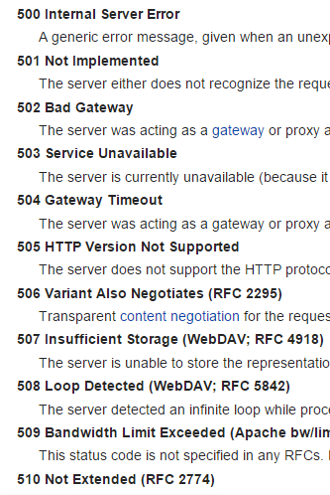
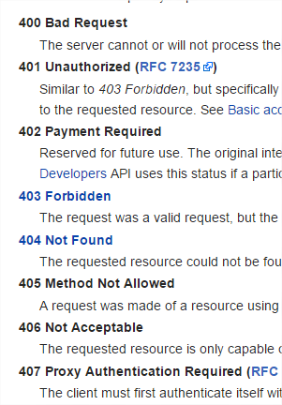
Error HTTP Status
https://en.wikipedia.org/wiki/List_of_HTTP_status_codes

Slide 13
Error Specification

Slide 14
Error Specification
Back & Front ends need to sync on the error format
It needs to be
Simple
Flexible
Consistent

Slide 15
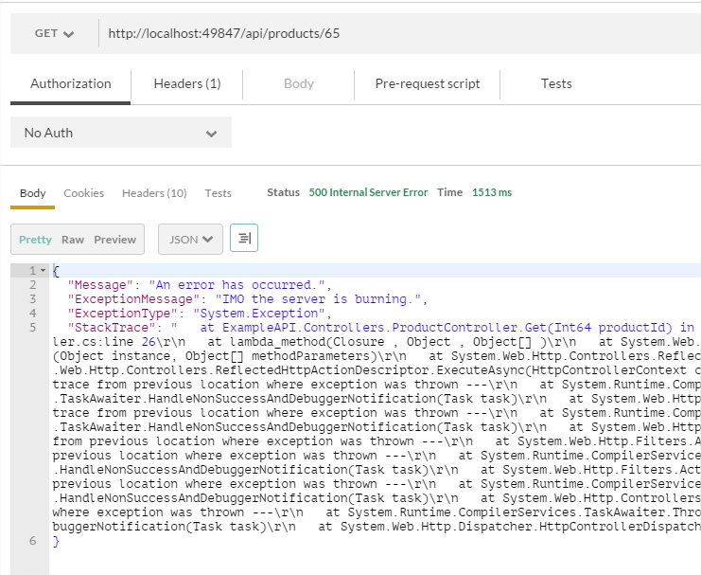
Error Specification
Default ASP.NET Web API errors are not acceptable

Slide 16
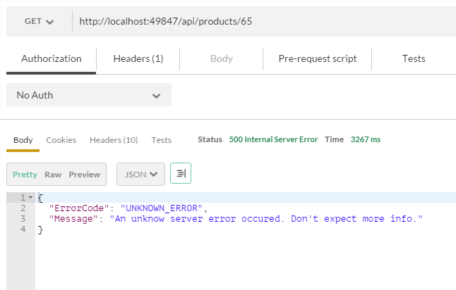
Error Specification
A better format is human readable

Slide 17
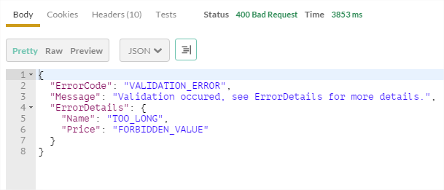
Error Specification
It is flexible for validation

Slide 18
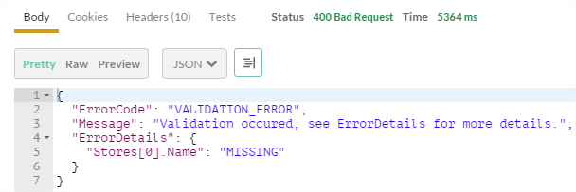
Error Specification
It can handle inner lists or objects

Slide 19
Error Specification
Server errors :
return minimum info
System Exception: Could not connect to database

Slide 20
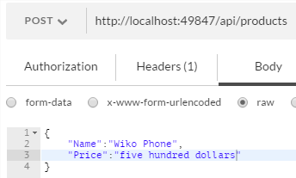
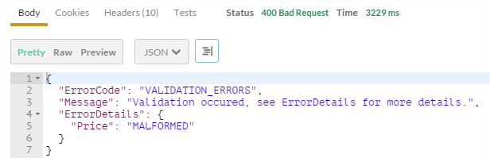
Error Specification
Client validation error :
return static error Code + error details

Slide 21
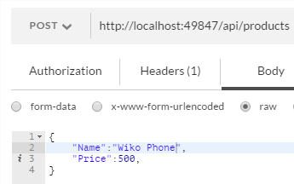
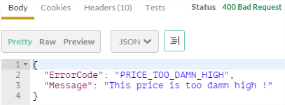
Error Specification
Client errors :
return business error code

Slide 22
Setting up the API

Slide 23
Setting up the API
The error handling systems essentially relies on usage of attributes for :
Model validation
Actions filtering
Exceptions filtering

Slide 24
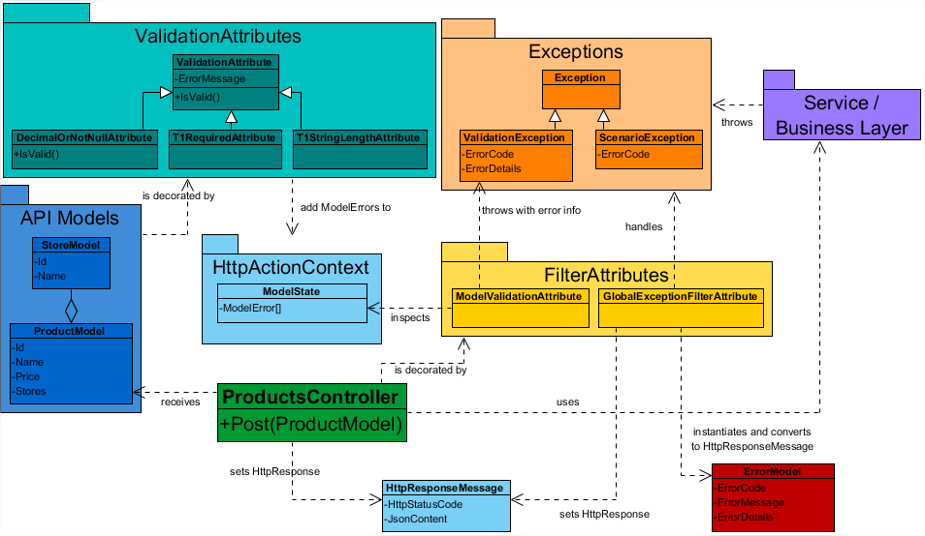
Class Diagram

Slide 25
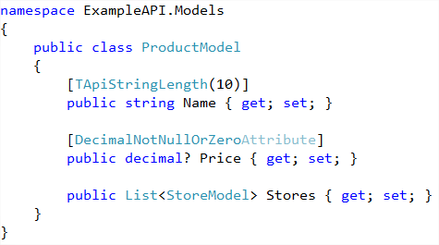
Setting up the API : Models
POCO + Validation attributes

Slide 26
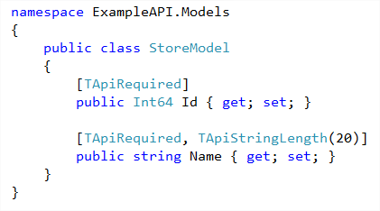
Setting up the API : Models
POCO + Validation attributes

Slide 27
Class Diagram

Slide 28
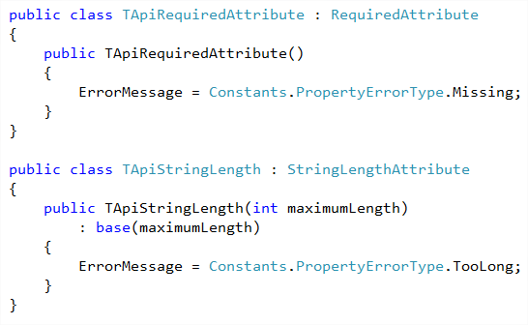
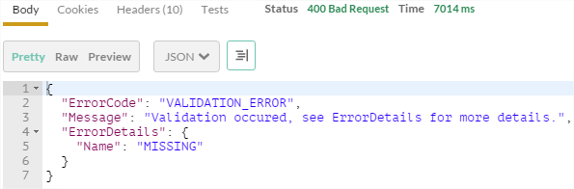
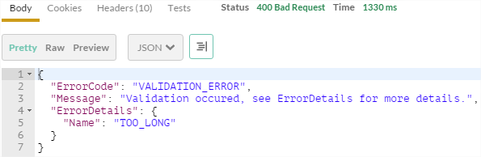
Setting up the API : model attributes

Slide 29
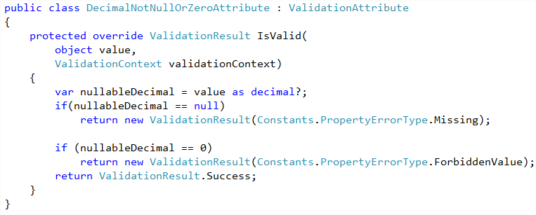
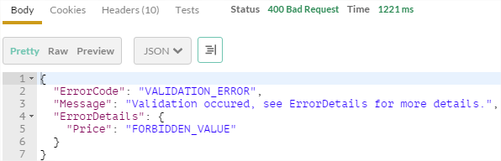
Setting up the API : model attributes

Slide 30
Class Diagram

Slide 31
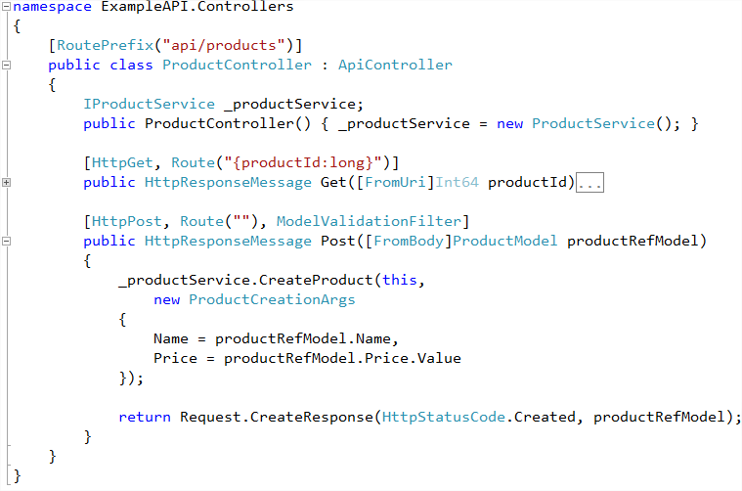
Setting up the API : Controller

Slide 32
Throwing and Catching with Filter Attributes

Slide 33
Filter Attributes
Filter attributes act as « side code » for actions
(logs, security, validation, exception handling, …)
They can be applied to
Single actions
Entire Controllers
The whole API
They can run before or after the action

Slide 34
Class Diagram

Slide 35
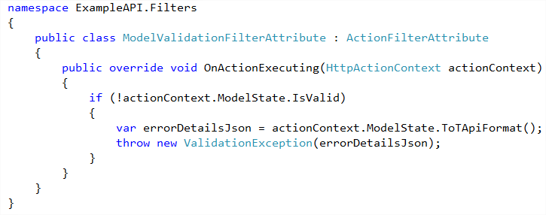
Throwing & Catching : Action Validation Filter

Slide 36
Class Diagram : Exception Filter attributes
Core class of the system

Slide 37
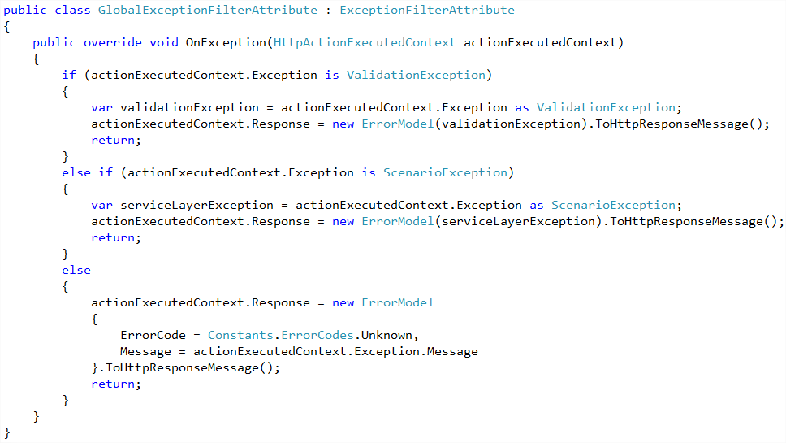
Throwing & Catching : Exception Filter Attribute

Slide 38
Throwing & Catching : Action Validation Filter
Validation Exception

Slide 39
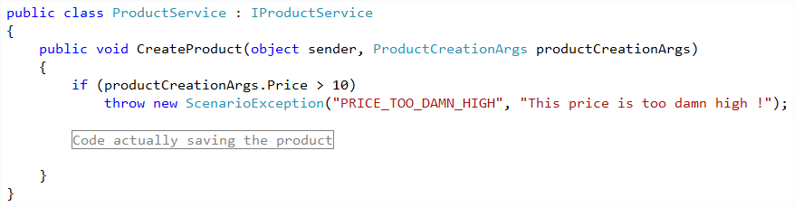
Throwing & Catching : scenario exceptions
Scenario Exception

Slide 40
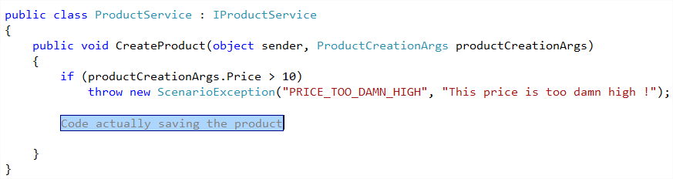
Throwing & Catching : system exceptions
System Exception

Slide 41
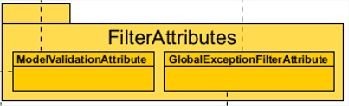
Throwing & Catching
Three Exceptions types get handled
by one single class
Scenario Exception
Validation Exception
System Exception

Slide 42
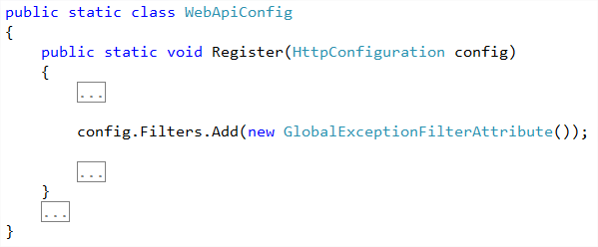
Throwing & Catching : making the filter global
The Exception Filter Attribute is applied to the entire API

Slide 43
Class Diagram : Exceptions

Slide 44
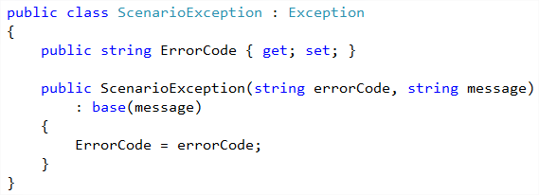
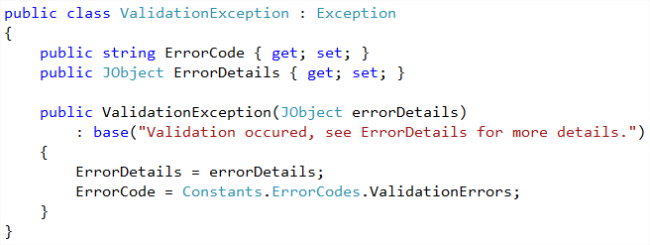
Throwing & Catching: Exceptions

Slide 45
Class Diagram : Error Model

Slide 46
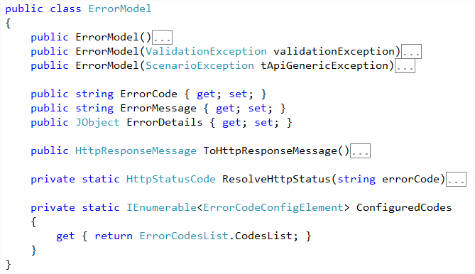
Class Diagram : Error Model

Slide 47
Some Sequence Diagrams

Slide 48
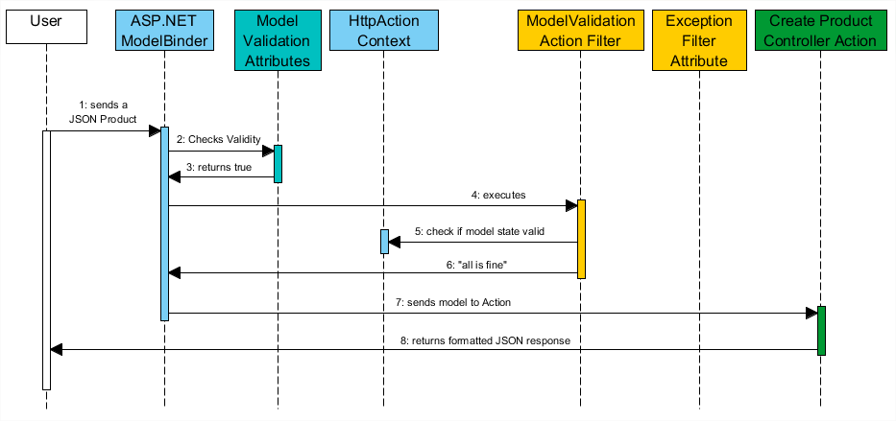
Nominal scenario

Slide 49
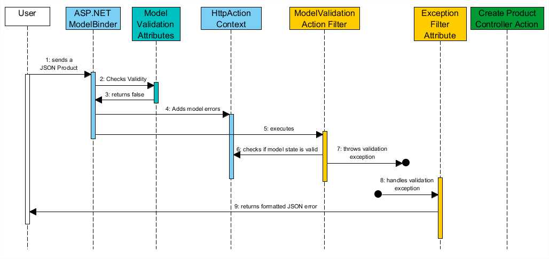
Validation errors

Slide 50
Helpers & Converters

Slide 51
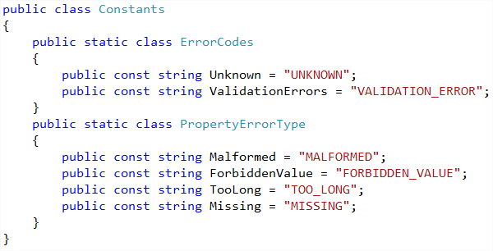
Helpers & Converters : constants

Slide 52
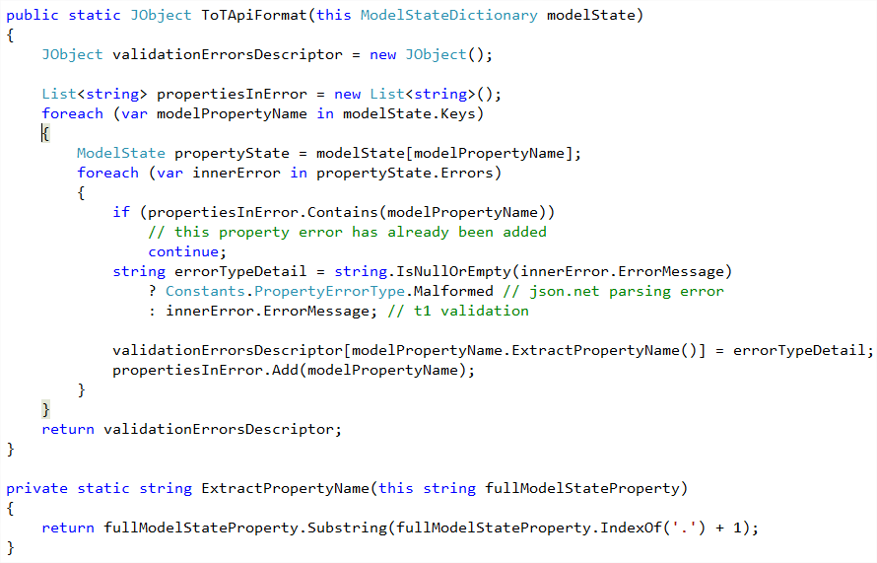
Helpers & converters : model errors extraction

Slide 53
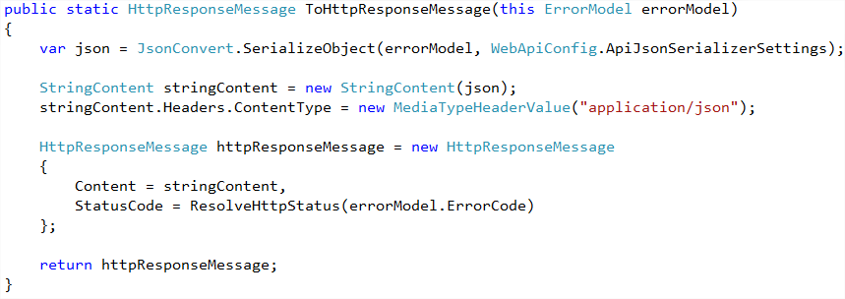
Helpers & Converters : HttpResponse Message conversion

Slide 54
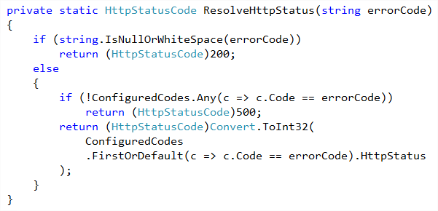
Helpers & Converters : HttpResponse Message conversion

Slide 55
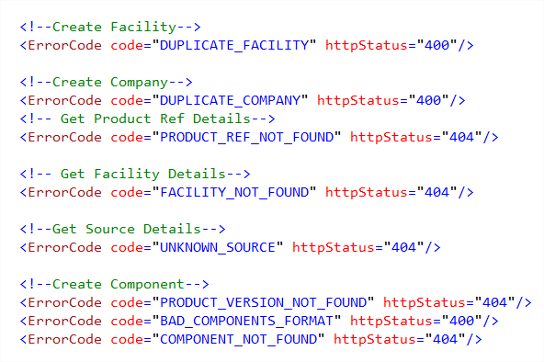
Helpers & Converters : Custom Error Config Section

Slide 56
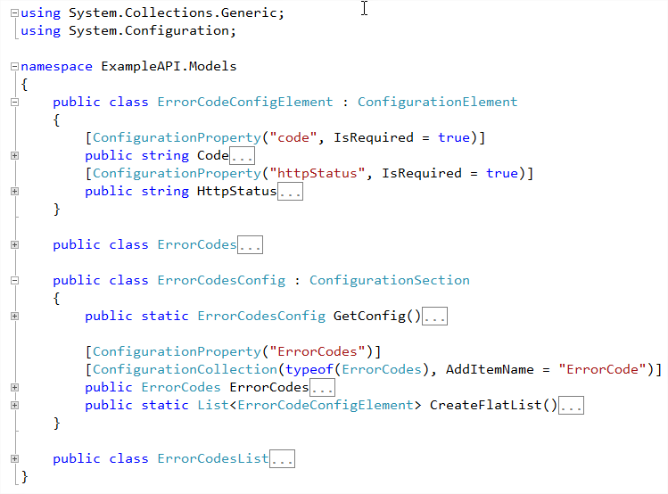
Helpers & Converters : custom error config section

Slide 57
Areas for improvement
JSON input validation : JSON Schéma ?
Using Dictionary to retrieve client error messages

Slide 58
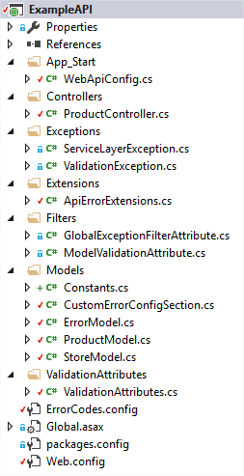
Example Solution
I created an example solution using this Error Handling System

Slide 59
Do you have questions ?

